Slide 1

The Many Faces of Cancer
DATA SCIENCE FINAL PROJECT

Slide 2



Cancer and the Effects on Females Nationwide
STATE
RACE.
POPULATION

Slide 3
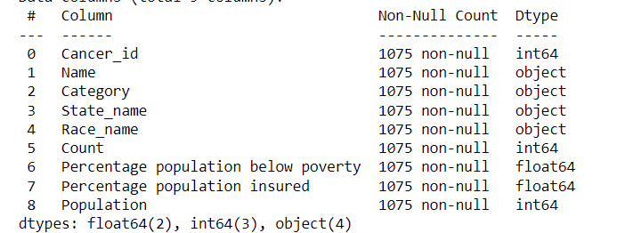
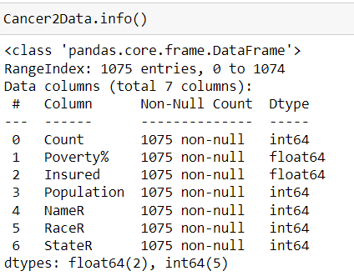
Data Types
Float – a # w/decimals
Categorical Data
Cancer type – Nominal Data
Race – Nominal Data
State – Nominal Data
Numerical Data
Percent of the Population below Poverty – Continuous Numerical Data
Percent of the Population Insured – Continuous Numerical Data
Population – Discrete Numerical Data

Slide 4
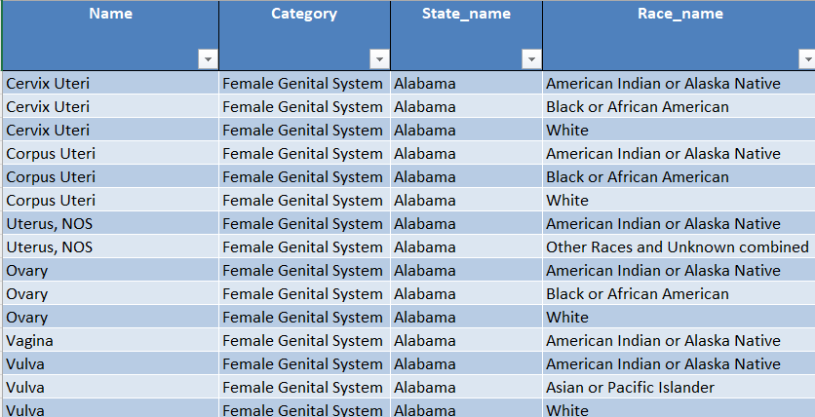
Pivot.wide

Slide 5
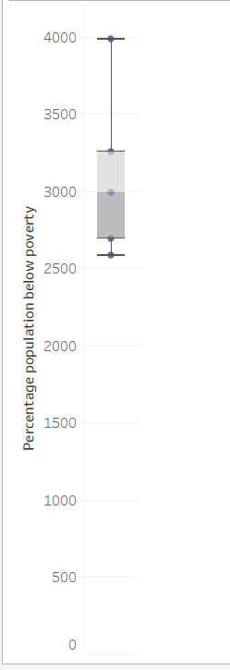
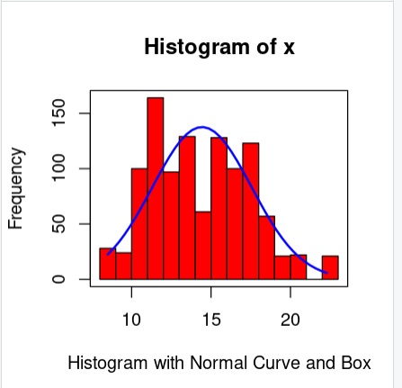
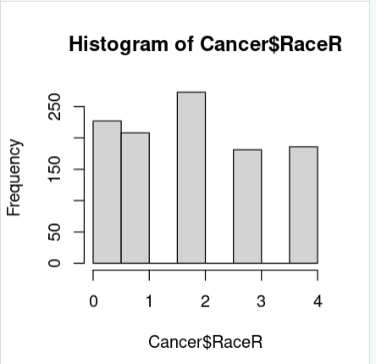
Question 1 - Tameka
Is there a correlation between the percent population below poverty to race?
- There aren’t any outliers evident, but there is a larger Caucasian population.

Slide 6
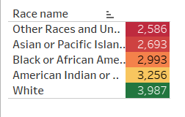
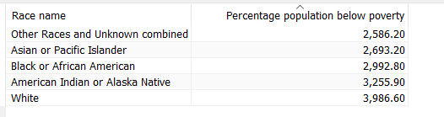
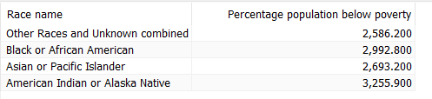
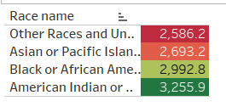
Excluding the outlier ‘White’ or ‘Caucasian’

Slide 7
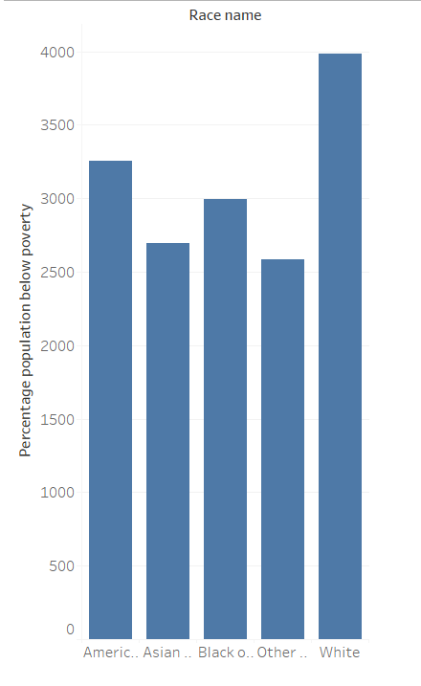
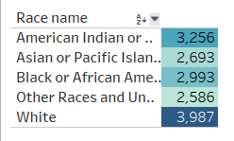

Slide 8
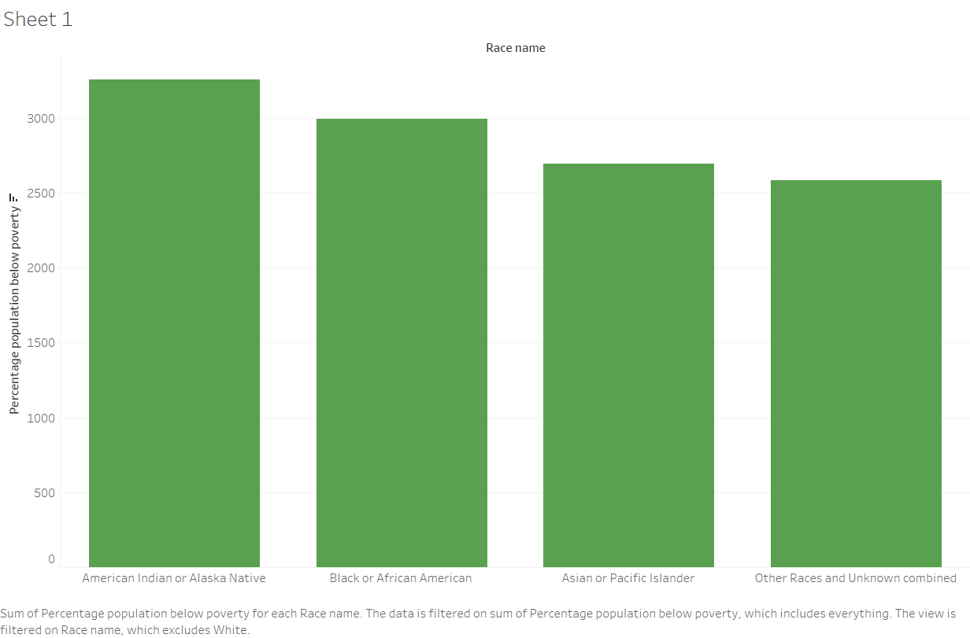

Slide 9
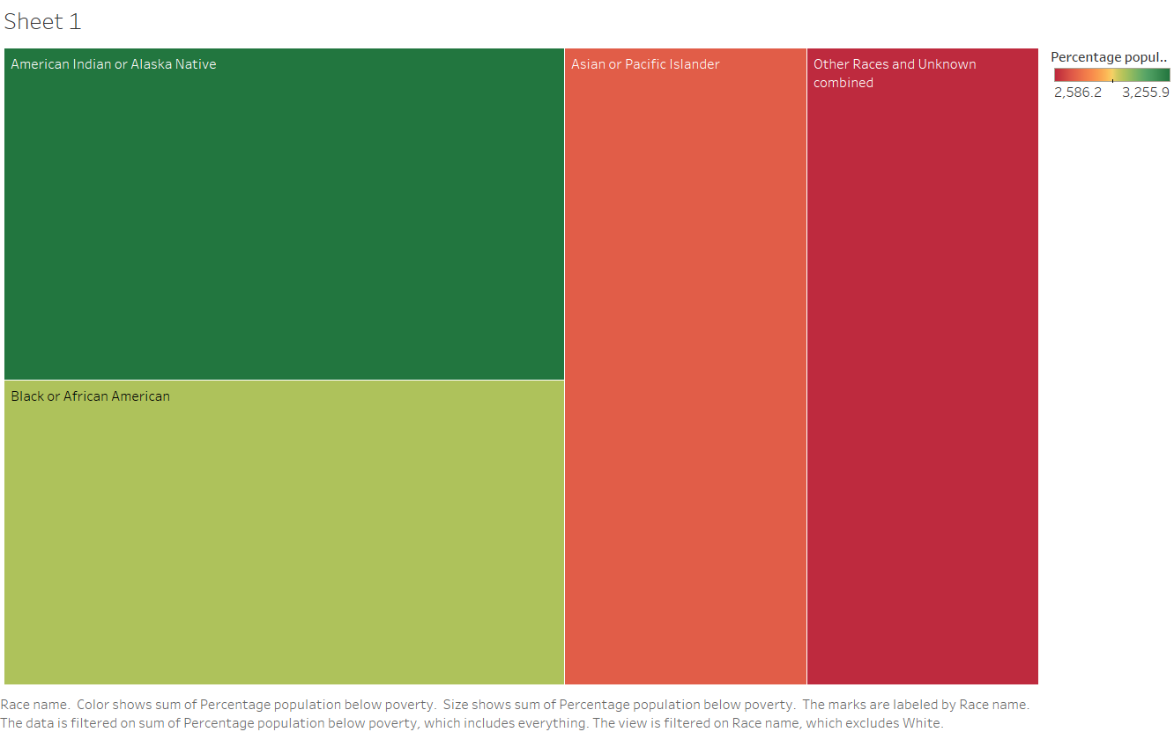

Slide 10
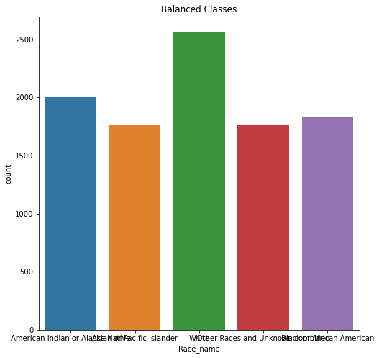
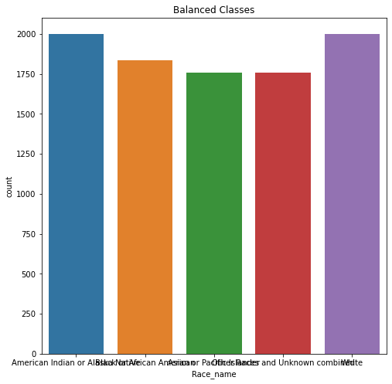
Race Transformations Talia Credit (Alison made some adjustments]
Before! From original dataset
After! From original dataset (credit 100% Talia)
NativeAmer, AfricanAmer, White, Other, AsianAmer
NativeAmer, AfricanAmer, AsianAmer, Other, White

Slide 11
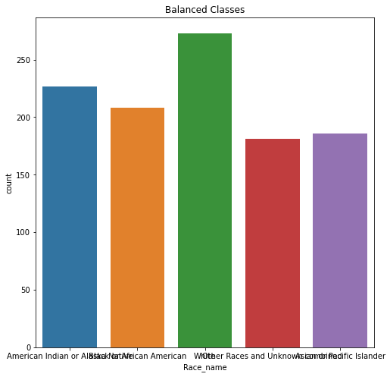
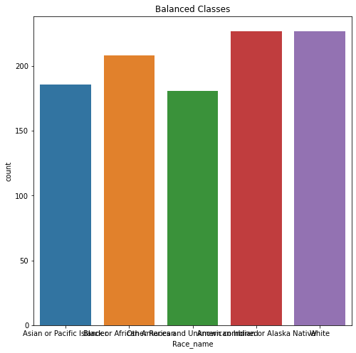
Race Transformations Talia Credit (Alison made some adjustments]
Before (from Third Dataset)
After (from Third Dataset)
NativeAmer, AfricanAmer, White, Other, AsianAmer
AsianAmer, AfricanAmer, Other, NativeAmer, White
Notes:
Before Value Counts
White 273
American Indian or Alaska Native 227
Black or African American 208
Asian or Pacific Islander 186
Other Races and Unknown combined 181
After
NativeAmer = White

Slide 12
Question 2 - Alison
Last Week - Which race has the highest female cancer health concerns compared to the total population?
Conclusion: The Caucasian race had the highest health concerns but the data was shown to be positive skewed due to the largest population amount.
AfricanAmer = 1,448,668,350, AsianAmer = 1,216,128,393, Caucasian = 2,087,855,957, NativeAmer = 1,227,306,380, Other = 935,712,060
This Week -
Still Caucasian (used Tableau)
AfricanAmer = 1,448,668,350, AsianAmer = 1,216,128,393, Caucasian = 1.695.071.659 NativeAmer = 1,227,306,380, Other = 925,712,060

Slide 13
Question 2 - Alison
Last Week - Which race has the highest female cancer health concerns by each female genital system cancer?
Caucasian for Cervix Uteri, Corpus Uteri, Other Female Genital Organs, Ovary, Uterus, NOS, Vulva
NativeAmer for Vagina
This week (used Tableau) -
Caucasian for Cervix Uteri, Vulva
AftricanAmer for Corpus Uteri, Ovary
NativeAmer for Other Female Genital Organs, Uterus, NOS, Vagina,
Notes:
ALISON DO NEW CHI SQUARE FOR THIS QUESTION

Slide 14
Question 3 - Whitney
Which state has the highest female cancer level according to the percentage of the population below poverty?

Slide 15
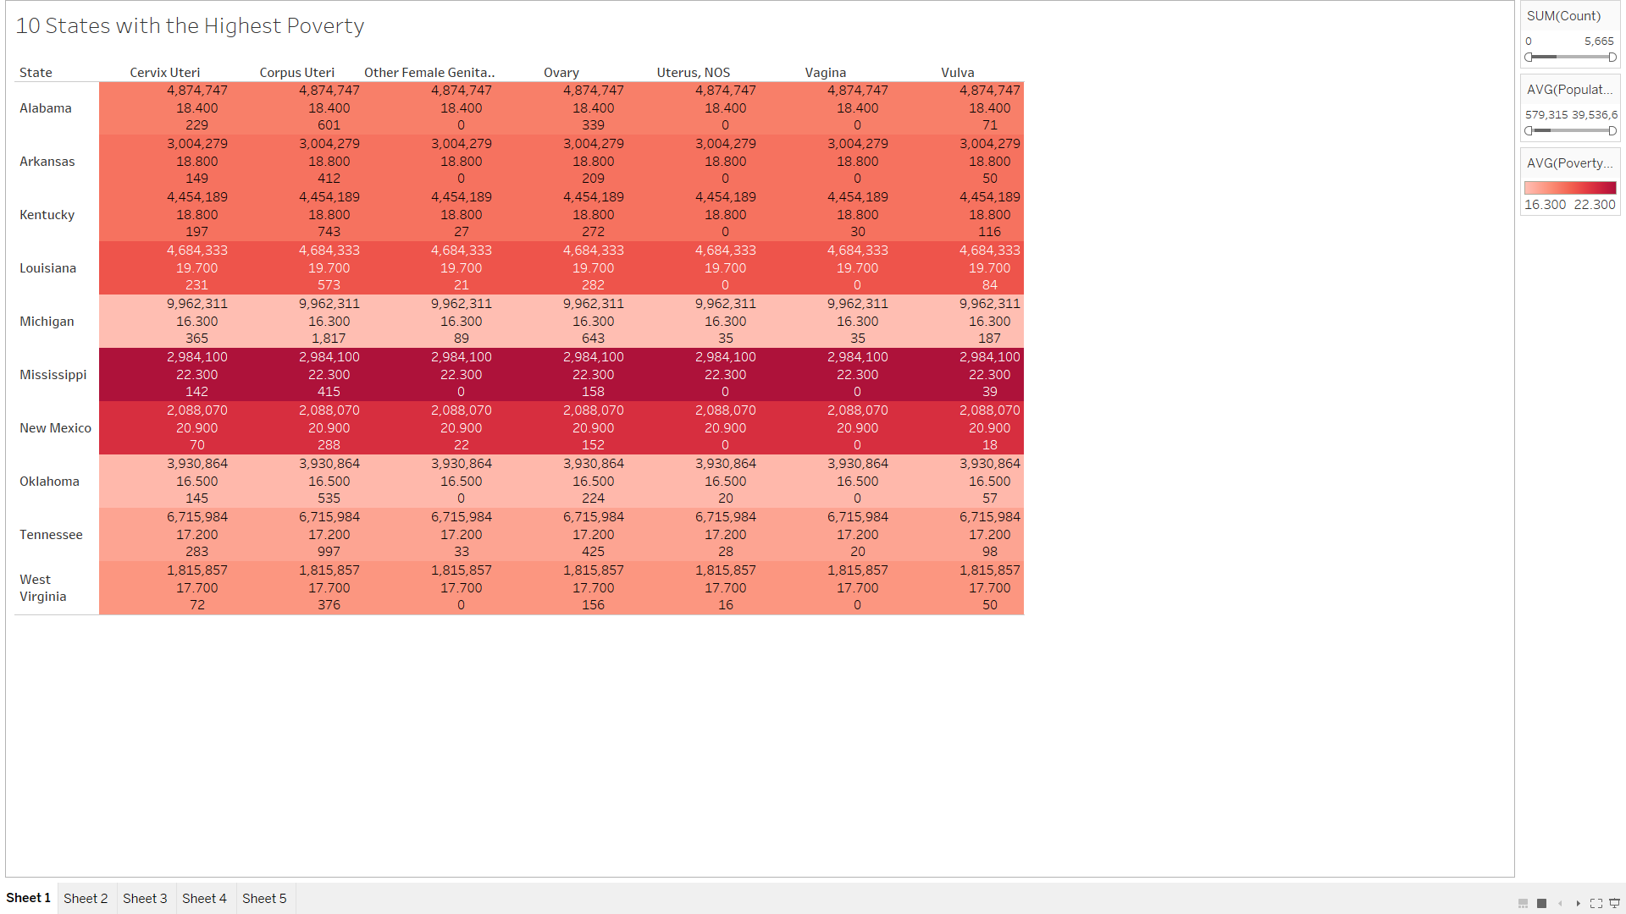
Question 3- Whitney

Slide 16
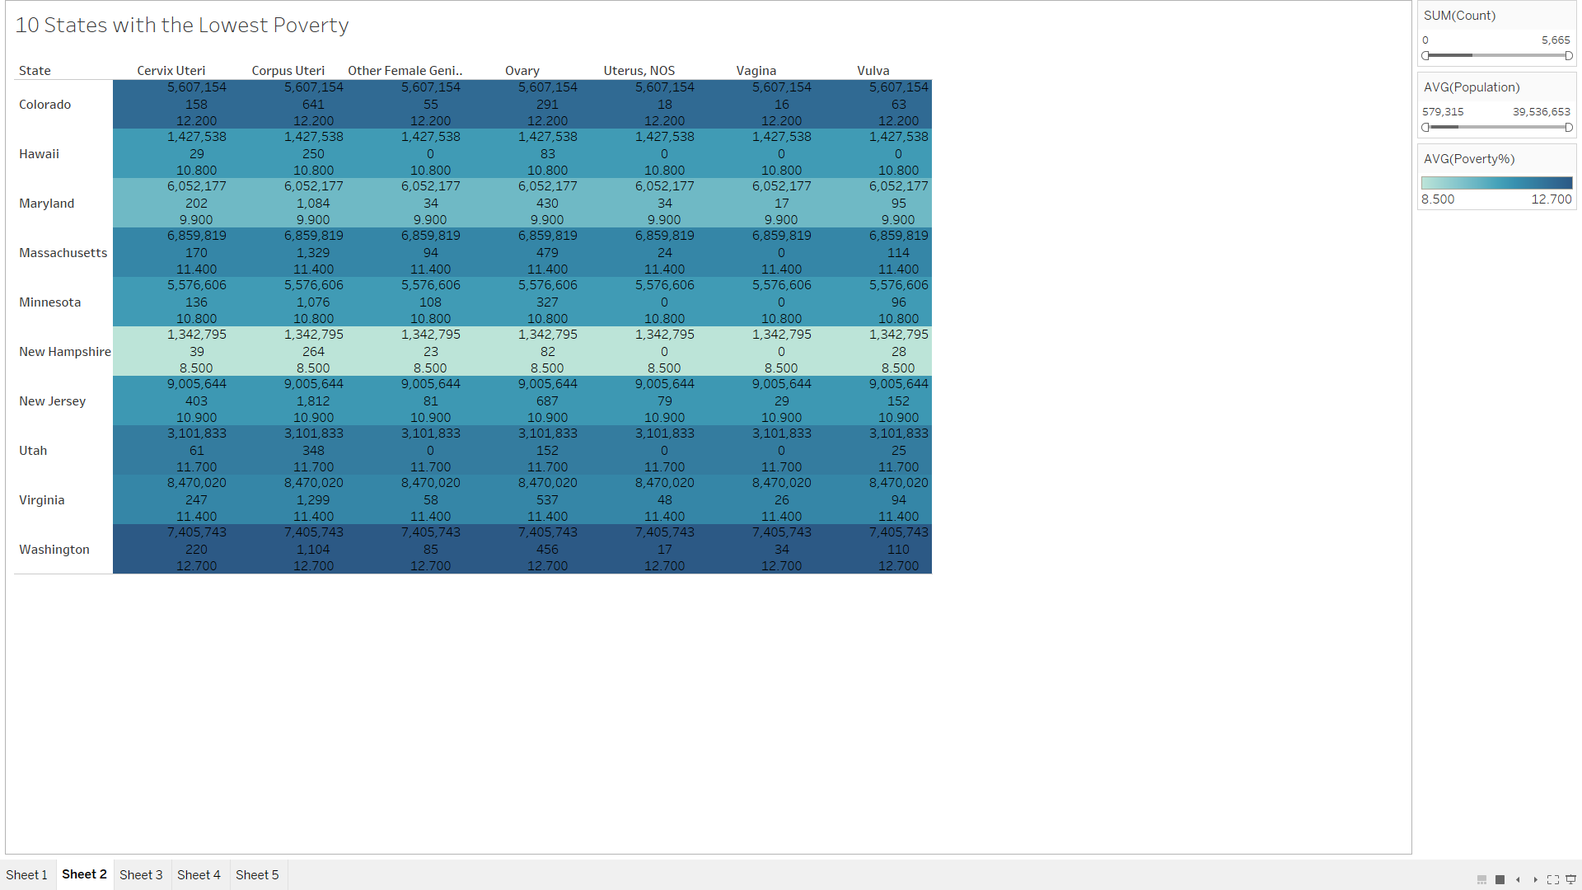
Question- 3

Slide 17
Question 4-Talia
Is there a correlation between the percent population below poverty to state?

Slide 18
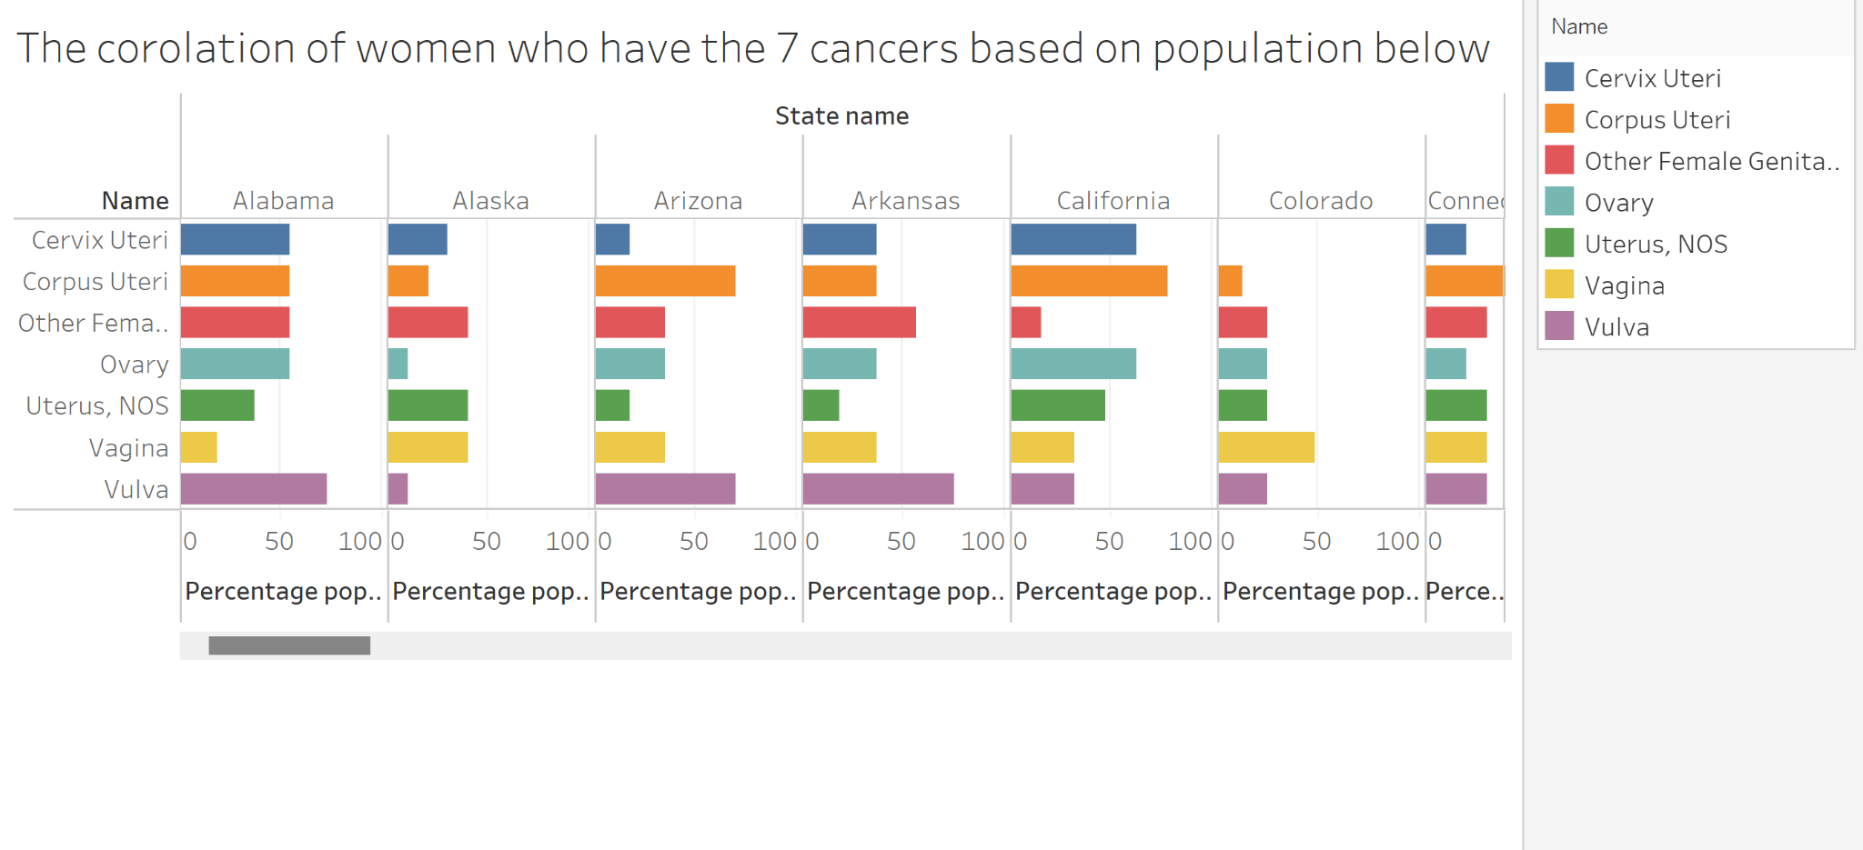
Sample Graph Question 4-Talia

Slide 19
DATA

Slide 20
R STUDIO

Slide 21
Python

Slide 22
Tableau

